Slide 1
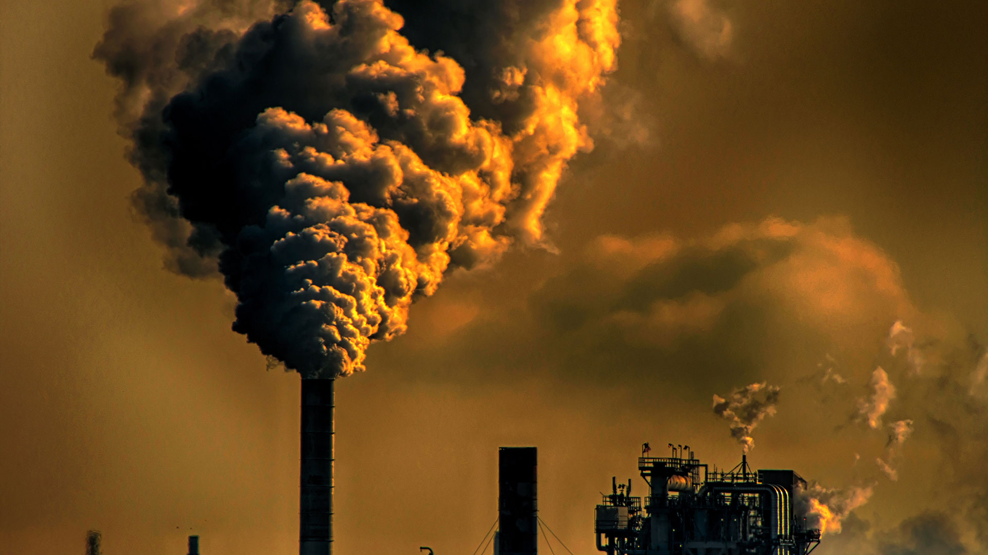




Air Quality and Pollution Prevention
Group 7

Slide 2

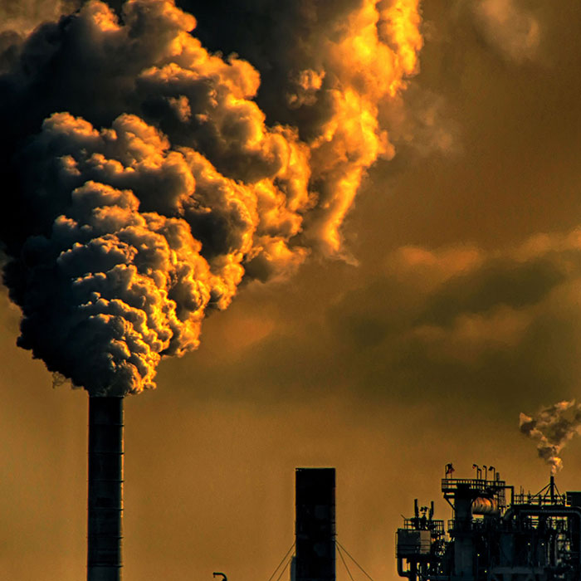
Presentation Outline
Overview
Some Forms of Air Pollution and Effects
Community Engagement and Responses
Data Visualization and Analysis
Conclusion

Slide 3

Overview
The sources of indoor air pollutants can be both natural and anthropogenic, including things like tobacco smoke, cleaning products, pesticides, building materials, and combustion byproducts.
Indoor air pollution has significant impact on human health, leading to range of health problems, eg respiratory illness, allergies, and asthma etc.

Slide 4

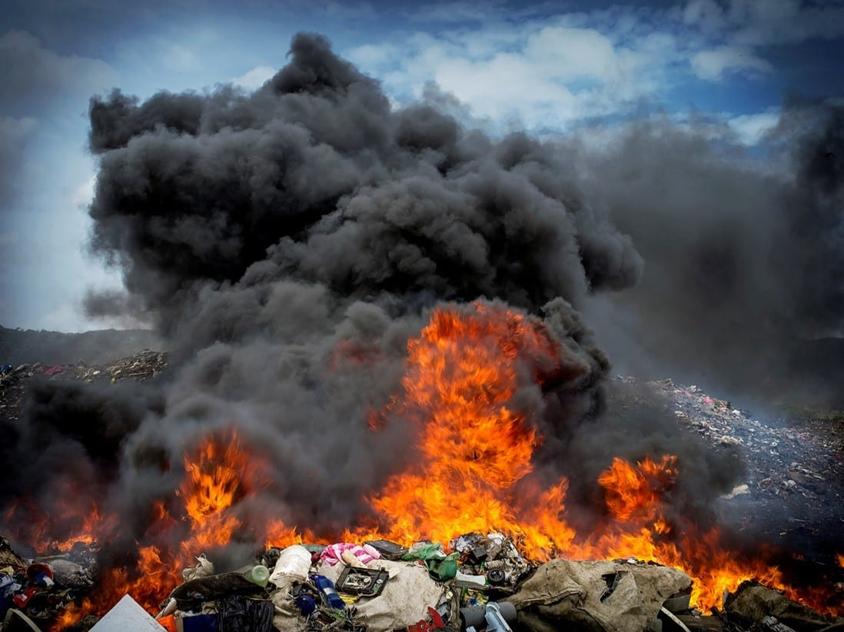
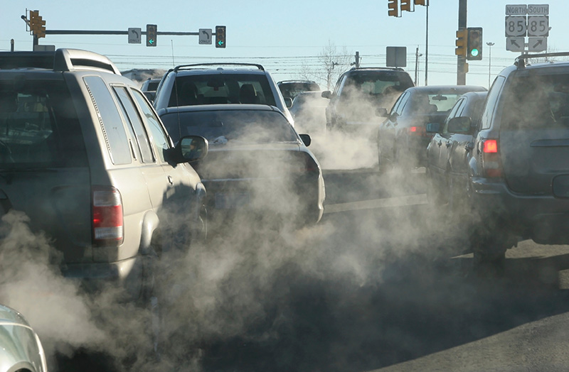
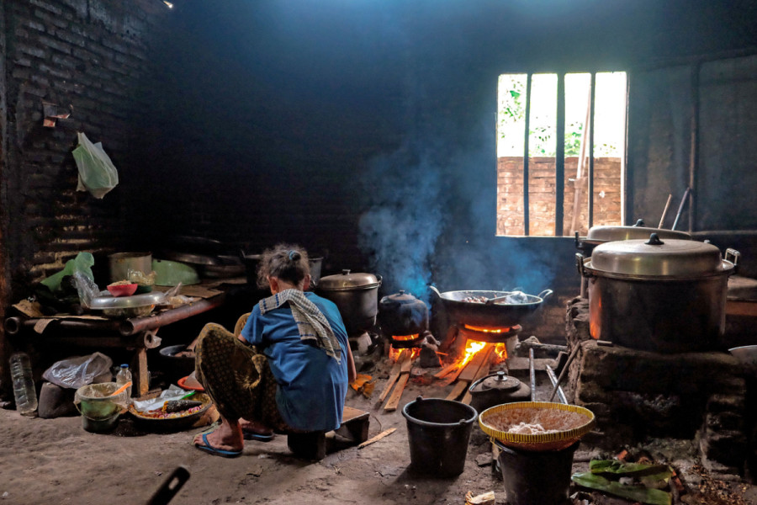
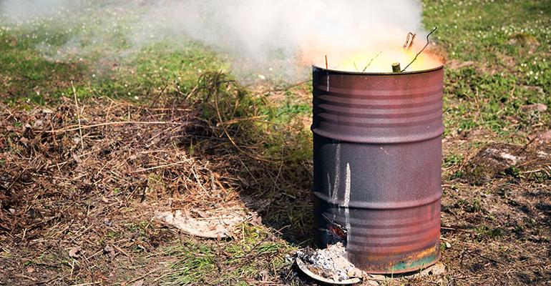
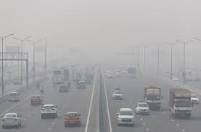
Forms of Air Pollution
Outdoor Air Pollution
Household Air Pollution
Example Of Ambient Pollution
Open Refuse Burning
Firewood Method of Cooking

Slide 5
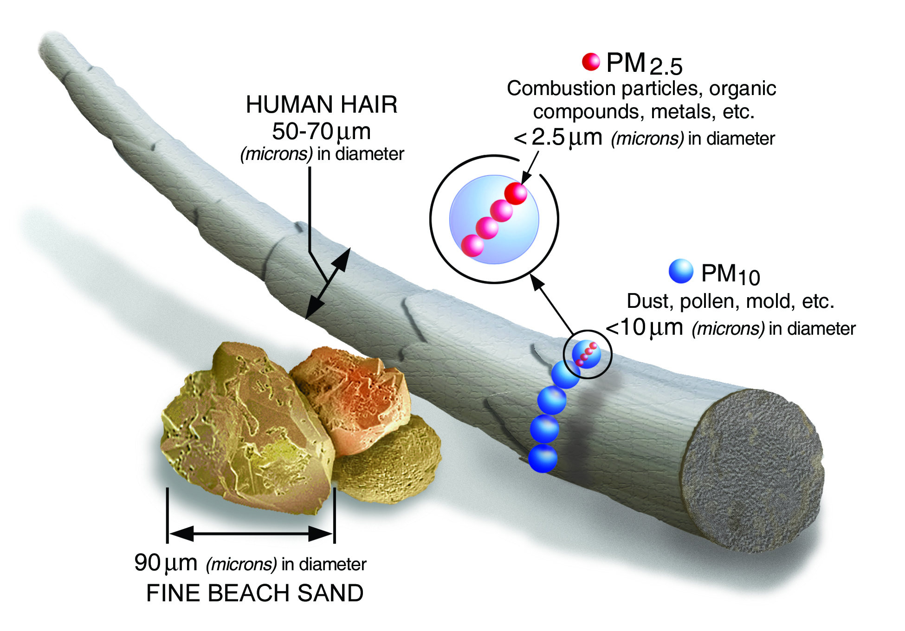
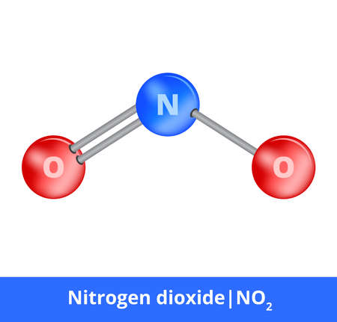
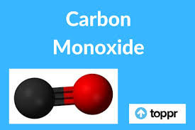

Forms of Air Pollution
Particulate Matter

Slide 6






Effects
Can cause coughing &
difficulty breathing
Can cause eye, nose & throat irritation
Can trigger asthma attacks
Can cause heart disease, abnormal heart rhythms, congestive heart failure, stroke, & premature death
Can affect the development of children’s lungs

Slide 7

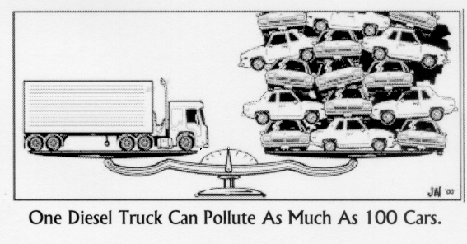

Slide 8
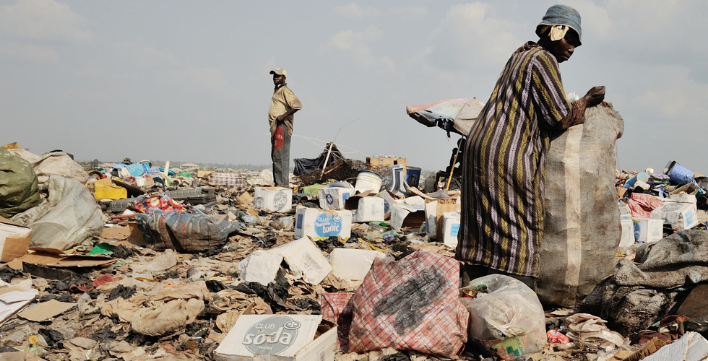
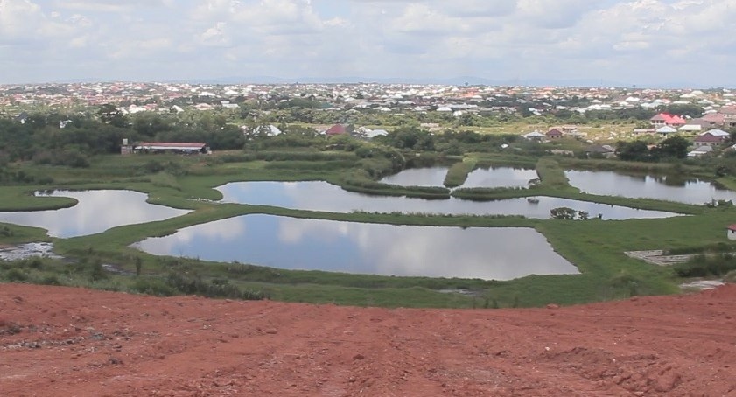
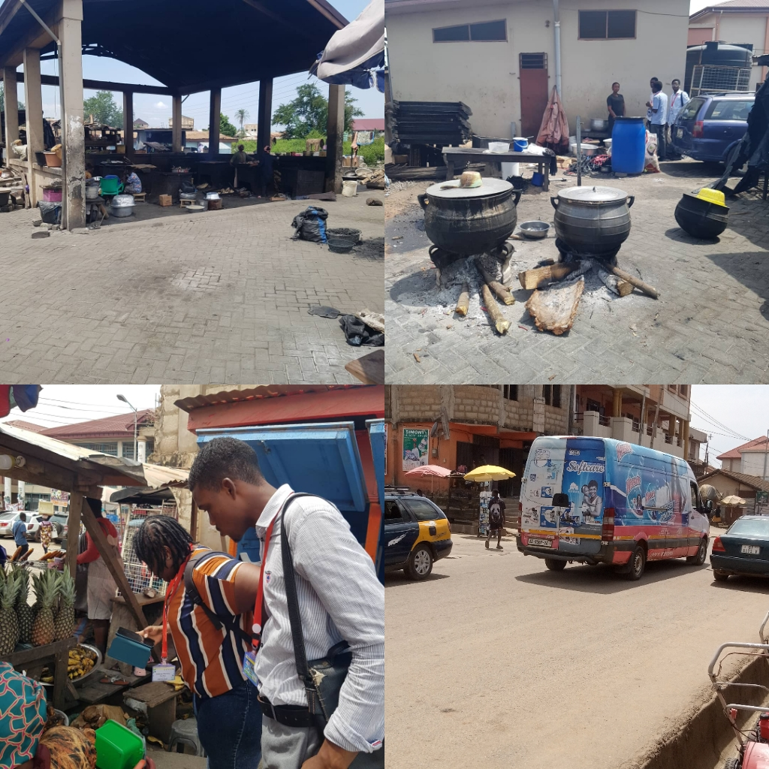
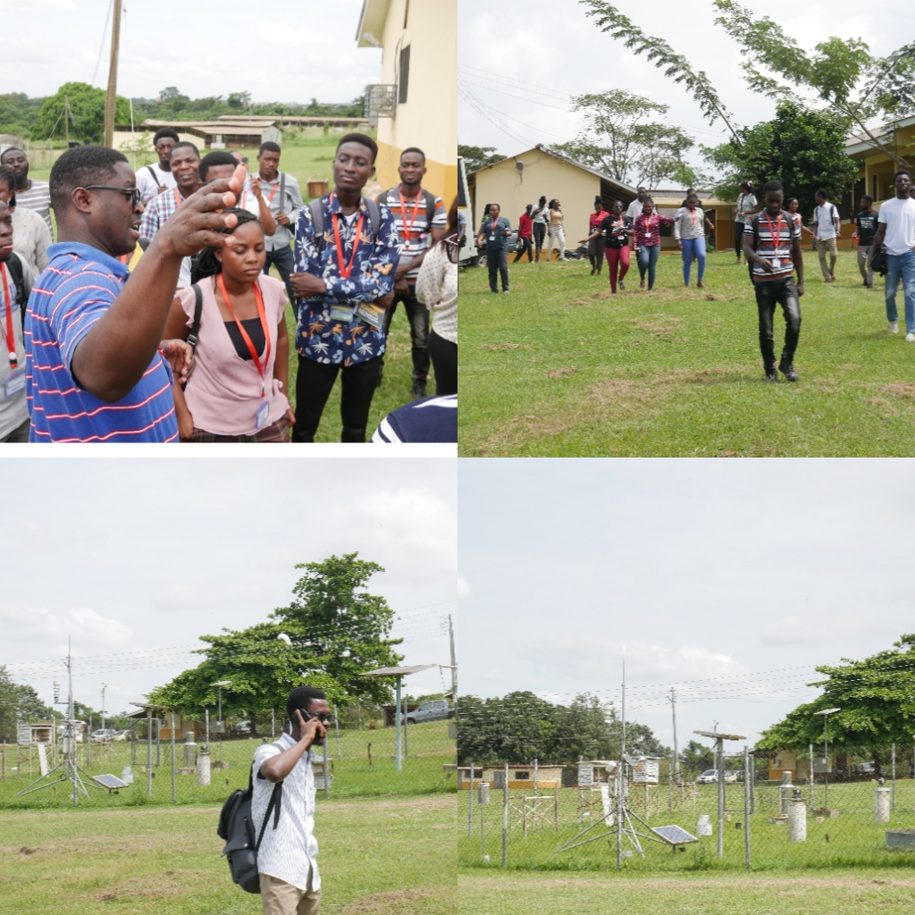
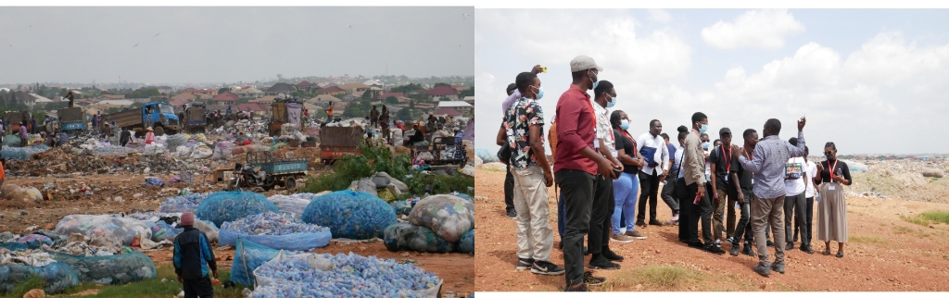
Community Engagement and Site Visitation
The Kumasi , Oti Landfill site
Atonsu High School Junction
The AgroMet Station

Slide 9
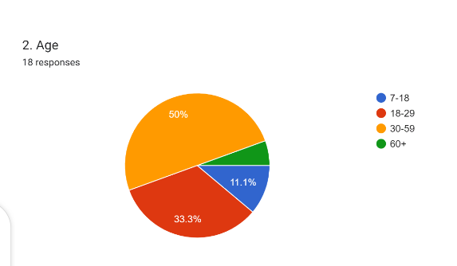
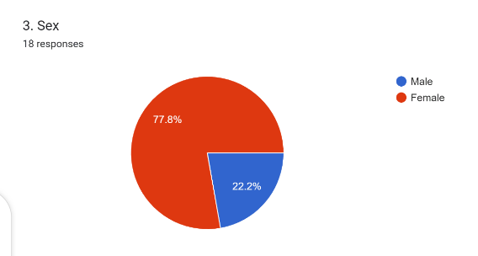
Community Engagement and Site Visitation (Atonsu High School Junction)

Slide 10
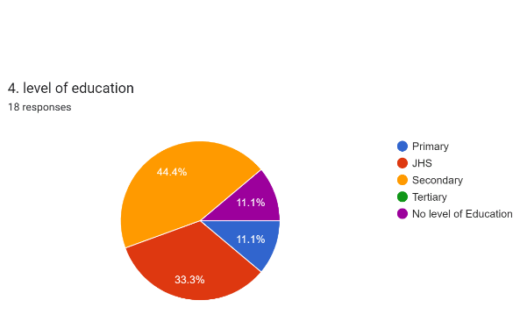
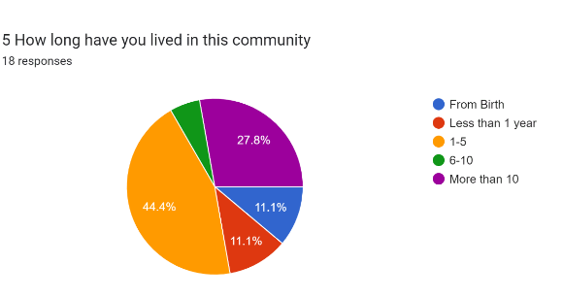
Community Engagement and Site Visitation (Atonsu High School Junction)

Slide 11
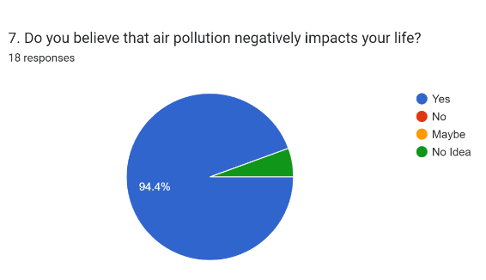
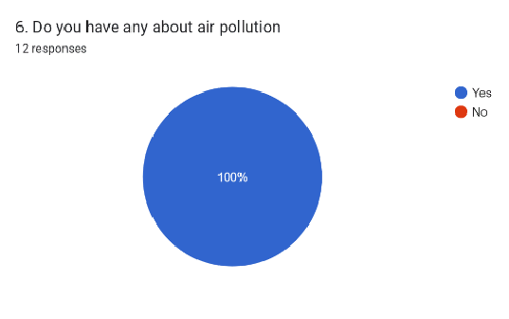
Community Engagement and Site Visitation (Atonsu High School Junction)

Slide 12
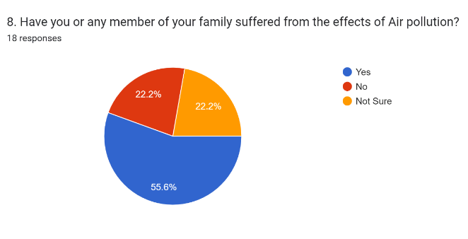
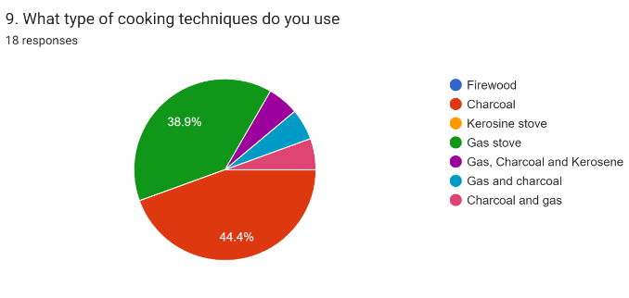
Community Engagement and Site Visitation (Atonsu High School Junction)

Slide 13
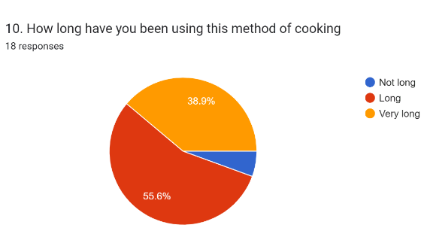
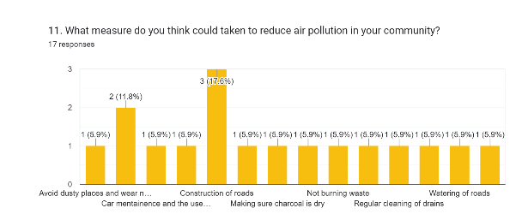
Community Engagement and Site Visitation (Atonsu High School Junction)

Slide 14
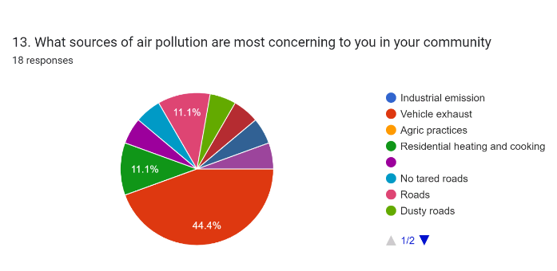
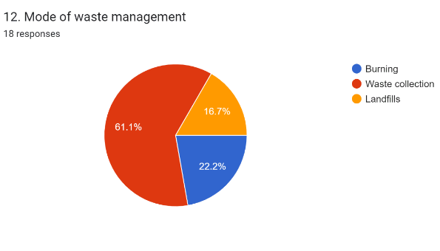
Community Engagement and Site Visitation (Atonsu High School Junction)

Slide 15
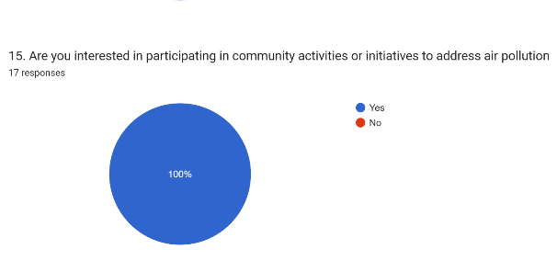
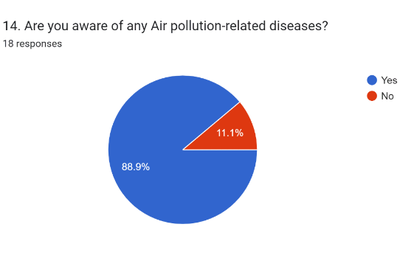
Community Engagement and Site Visitation (Atonsu High School Junction)

Slide 16
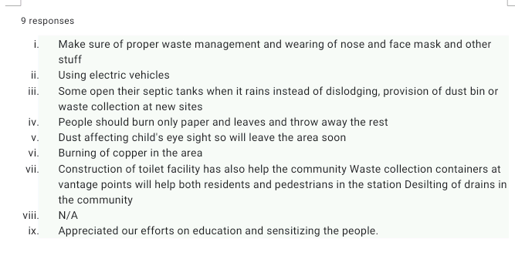
Community Engagement and Site Visitation (Atonsu High School Junction)

Slide 17
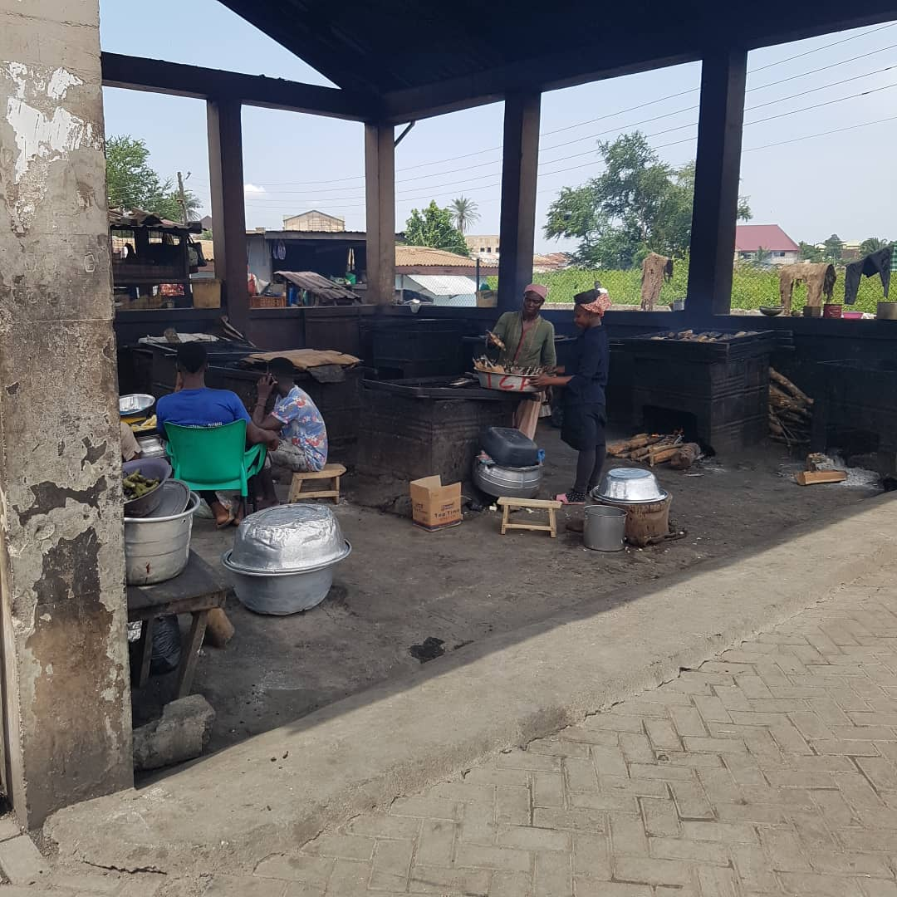
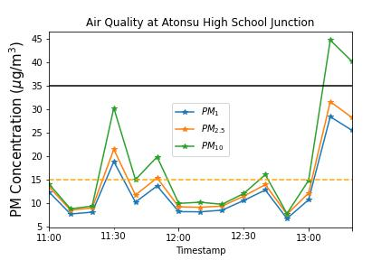
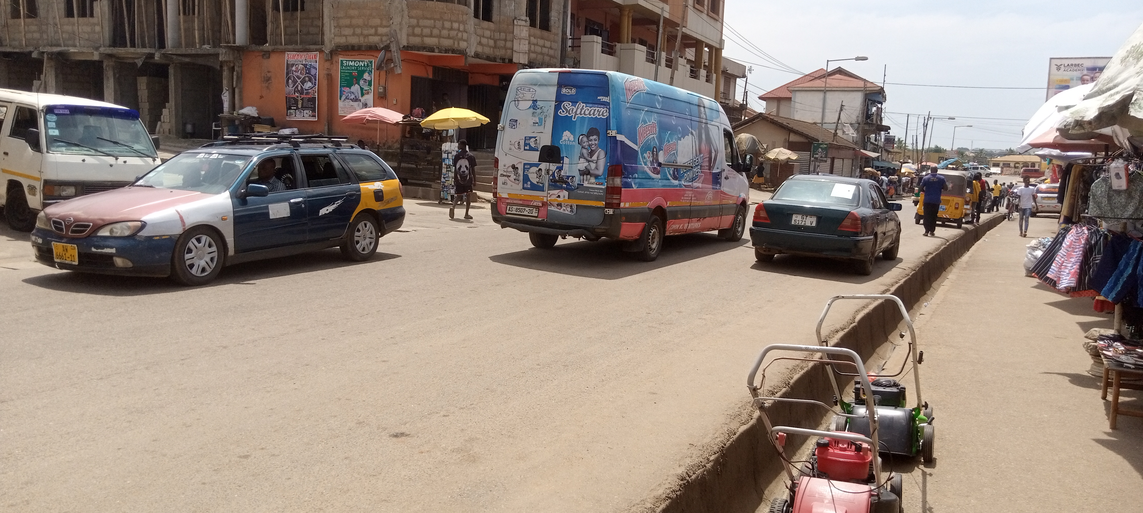
Community Engagement and Site Visitation (Results from pollution measurement)
Ghana Standard for PM 2.5
WHO threshold for PM 2.5

Slide 18
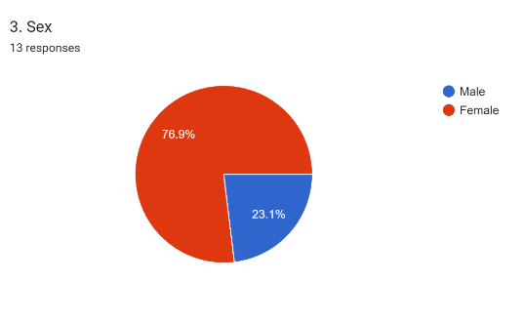
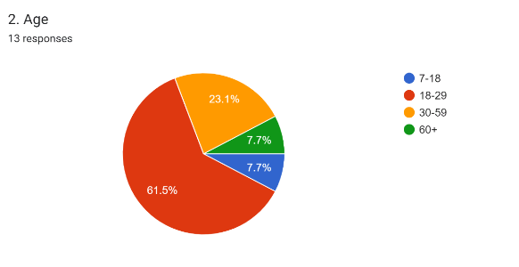
Community Engagement and Site Visitation (Landfill Site )

Slide 19
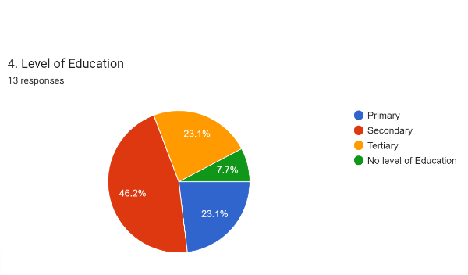
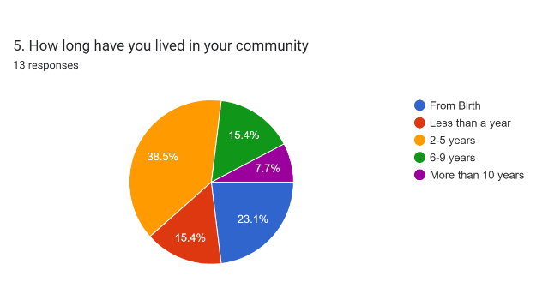
Community Engagement and Site Visitation (Landfill Site )

Slide 20
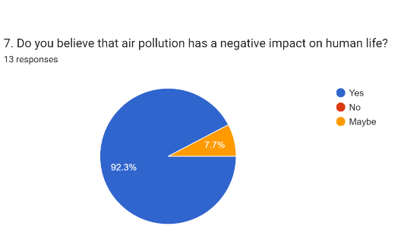
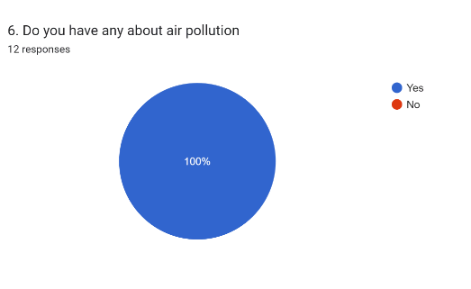
Community Engagement and Site Visitation (Landfill Site )

Slide 21
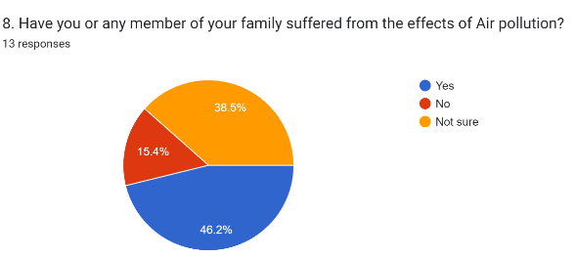
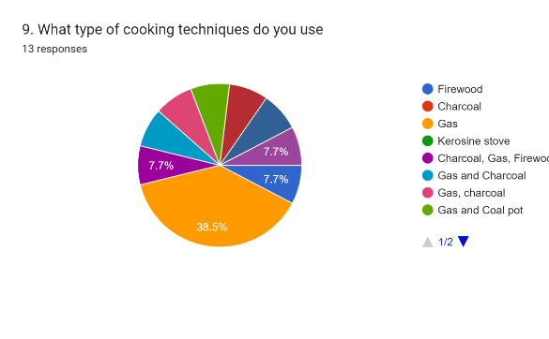
Community Engagement and Site Visitation (Landfill Site )

Slide 22
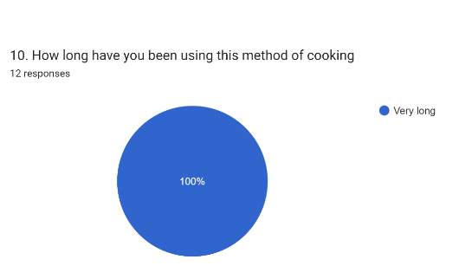
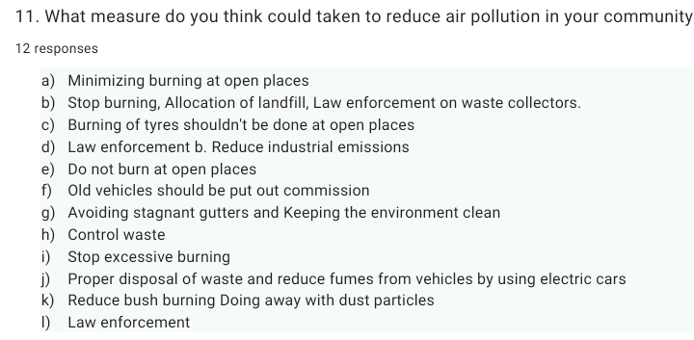
Community Engagement and Site Visitation (Landfill Site )

Slide 23
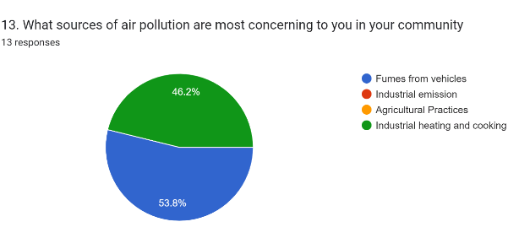
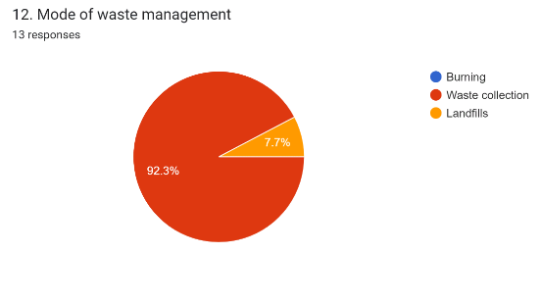
Community Engagement and Site Visitation (Landfill Site )

Slide 24
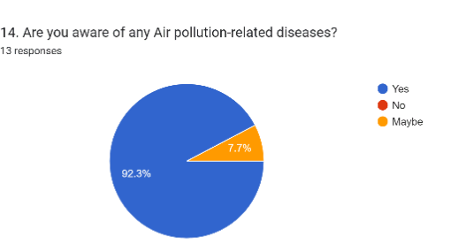
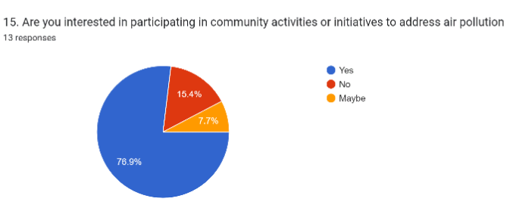
Community Engagement and Site Visitation (Landfill Site )

Slide 25
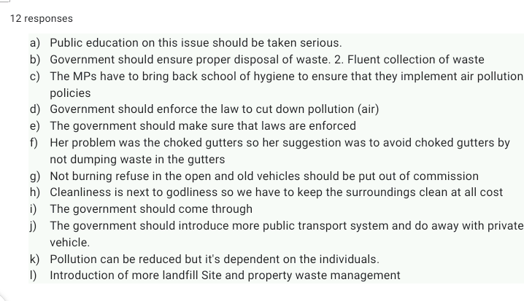
Community Engagement and Site Visitation (Landfill Site )

Slide 26
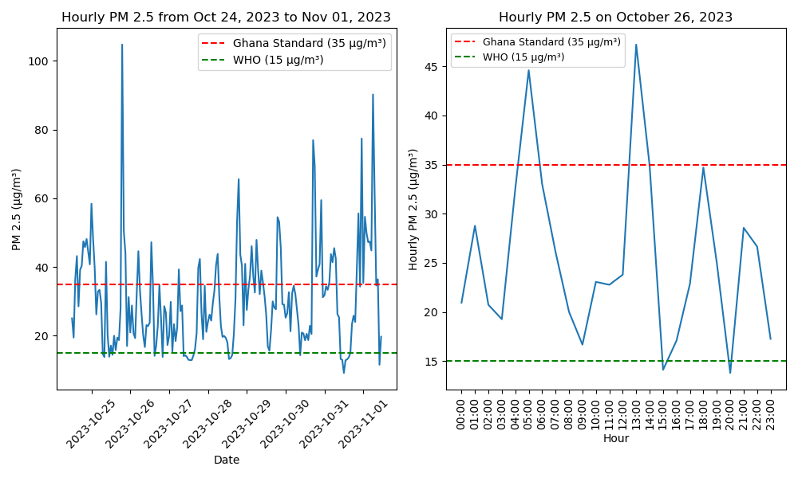
Data Visualization (Air Note) :Landfill Site

Slide 27

Data Visualization (Air Note) :Landfill Site

Slide 28


A Quote
““Love is in the air but the air is highly polluted””
~ Amit Abraham

Slide 29

Thank You

